Slide 1
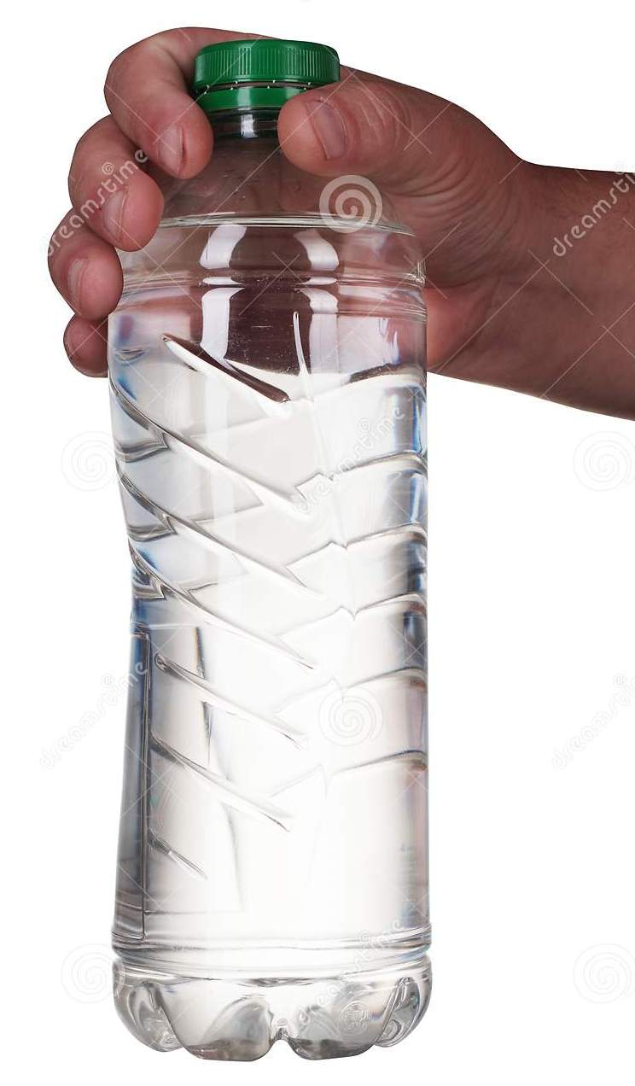
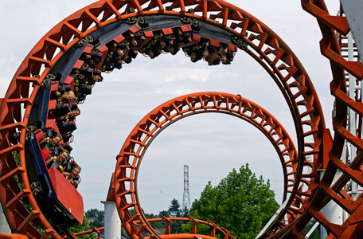

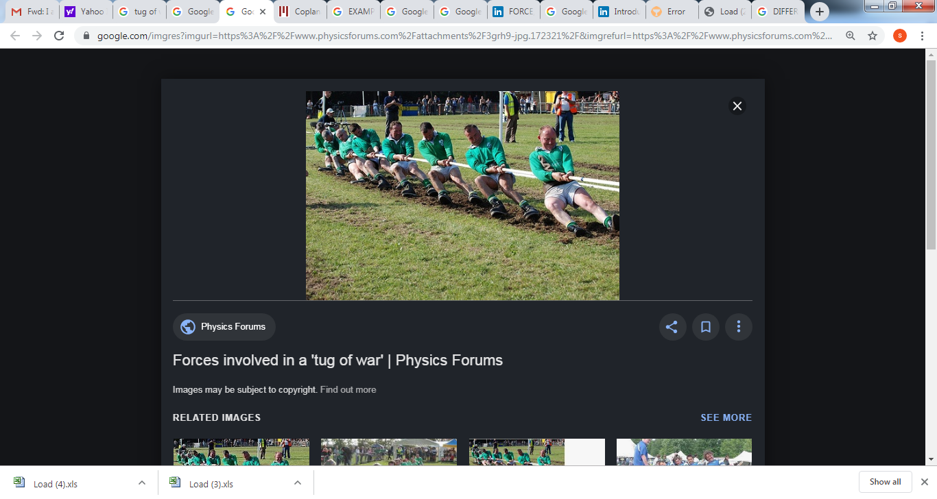
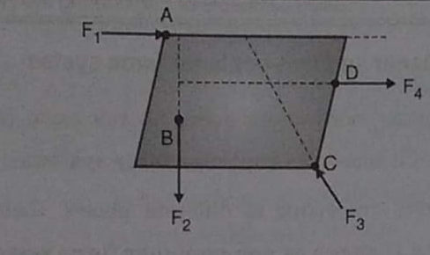
Lines of action are passing through multiple points.
Mechanics – 2.1
Basics of Mechanics
FY – DESH – VIT
Vishwakarma Institute of Technology
FY - Department of Engineering, Sciences and Humanities
F4
F3
F2
F1
NON CONCURRENT FORCES

Slide 2
What is Mechanics ?
It is the study of behavior of matter under the action of applied Forces.
It is a science that deals with study of Physical phenomenon.
What is Engineering Mechanics ?
It deals with …..
1) Laws and principles of Mechanics.
2) Application to the Engineering problems.
Vishwakarma Institute of Technology
FY - Department of Engineering, Sciences and Humanities
It helps an Engineer in …..
planning 2) designing 3) construction of various types of structures and machines.
e.g. Robots.

Slide 3
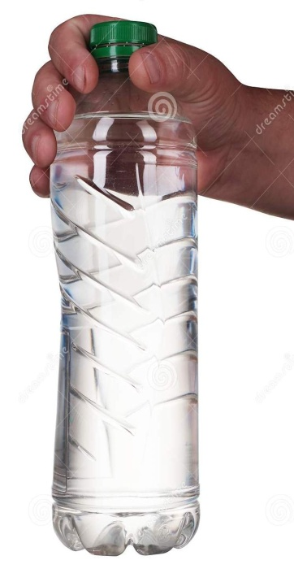

Roll of CG in Robotics
Vishwakarma Institute of Technology
FY - Department of Engineering, Sciences and Humanities
Empty Bottle
Half filled
Turned upside down !
Locate the CG of system of gripper and empty bottle
Is the CG of system at the same point ?
Where is the CG of system now ?

Slide 4
Facets of Engineering Mechanics : A Glance
Mechanics of Solids
Mechanics of Fluids
Mechanics of Rigid Bodies
Mechanics of Deformable Bodies
Vishwakarma Institute of Technology
FY - Department of Engineering, Sciences and Humanities
Statics
Dynamics
Elasticity
Plasticity
Ideal fluid
Viscous fluid
Incompressible fluid
Kinematics
Kinetics

Slide 5
Statics And Dynamics
Statics – Study of behavior of rigid bodies under the action of applied forces when they are at Rest
Dynamics – Study of behavior of rigid bodies under the action of applied forces when they are in Motion
Vishwakarma Institute of Technology
FY - Department of Engineering, Sciences and Humanities
Kinetics – Study of the Motion of the bodies due to the application of forces.
Kinematics – Study of motion of the bodies without considering the forces

Slide 6

Dynamics - Example
Kinetics –
Which forces ?
What direction ?
Kinematics –
How fast ??
How far ??
How long ??
Vishwakarma Institute of Technology
FY - Department of Engineering, Sciences and Humanities
Rollercoaster
Can you make a list of different physical quantities associated with this system ??

Slide 7
Importance of Statics and Dynamics in Robotics
A Robot is a rigid body. (What is a Rigid Body ?)
A Robot is acted by forces at rest and in motion.
A Robot needs to have …..
Coordination
Synchronization
Stability
Balance
within its structural parts at rest and in motion as well.
Vishwakarma Institute of Technology
FY - Department of Engineering, Sciences and Humanities
∴ Sound knowledge of Statics and Dynamics is necessary !

Slide 8
Particle – Body – Rigidity – Deformation
A particle occupies a point in space with negligible dimensions and has no size and shape.
A body is composed of infinite number of particles.
A body has definite size and shape.
A body is always limited in all directions.
In a Rigid body the distance between its particles does not change under the action of the forces.
Vishwakarma Institute of Technology
FY - Department of Engineering, Sciences and Humanities
Rigid body is an idealized concept as there is no body in the Universe which is 100% Rigid.
Every body always suffers from deformation. However, if it is extremely small, can be neglected and will not change its overall dimensions.

Slide 9
Rigid Body
Deformable Body
Negligible
Deformation
Considerable
Negligible change
Considerable change
Distance
between particles
Maintained
Equilibrium
Disturbed
Vishwakarma Institute of Technology
FY - Department of Engineering, Sciences and Humanities
No Motion
Motion
Motion takes place
No change
Size and
Shape
Changes

Slide 10
What is a Force?
Force is the capacity to do work.
Force produces motion in the body.
Force is a vector quantity, SI unit is Newton (Kg.m/s²)
Vishwakarma Institute of Technology
FY - Department of Engineering, Sciences and Humanities
Force causes…. 1) Translation or 2) Rotation or 3) both.

Slide 11
A Force has ………
Magnitude – for e.g. 100 Newtons.
Direction – angle made with + X axis. For e.g….
θ1 = + 50⁰ i.e. CCW (1st Quadrant)
θ2 = – 40⁰ i.e. CW (4th Quadrant)
F
F
Vishwakarma Institute of Technology
Sense – either a Push or a Pull.
FY - Department of Engineering, Sciences and Humanities
Point of Application of Force – It is the point on the body at which the force can be assumed to be concentrated.
Line of Action of Force – The line in which the force tends to move the body.

Slide 12
Force System
A “Force System” consists of multiple forces acting on a body at a point.
Types of Force system are …..
1) Co-planar and Non-Coplanar Force system
2) Concurrent and Non-Concurrent Force system
Vishwakarma Institute of Technology
FY - Department of Engineering, Sciences and Humanities
3) Parallel and Non-Parallel Force system
4) Collinear and Non-Collinear Force system

Slide 13
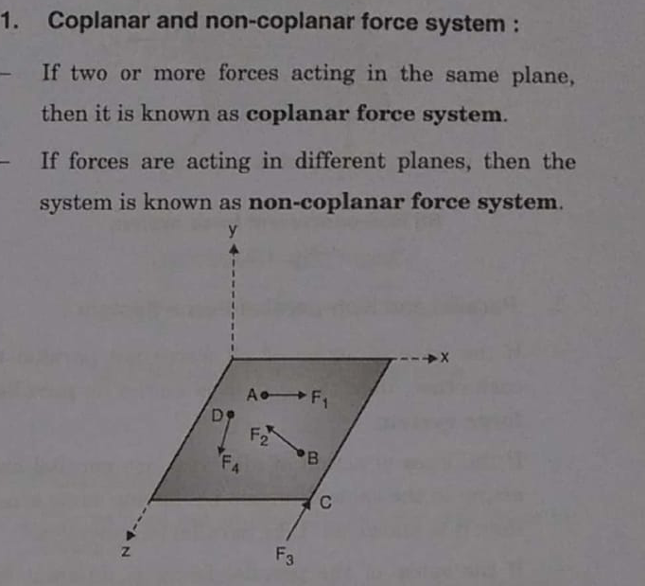
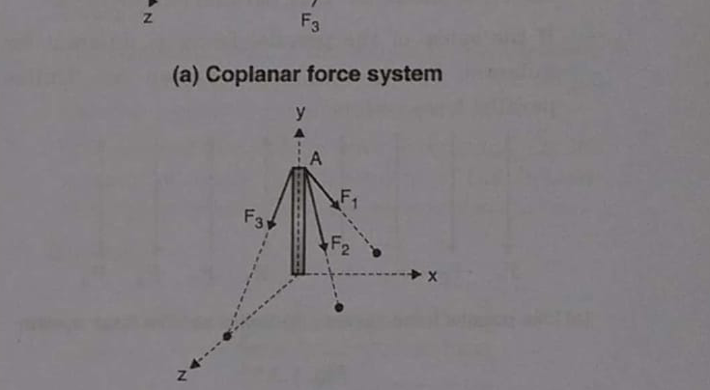
Co-Planar and Non Co-Planar Force system
Co-Planer Forces
Non Co-Planer Forces
Vishwakarma Institute of Technology
FY - Department of Engineering, Sciences and Humanities

Slide 14
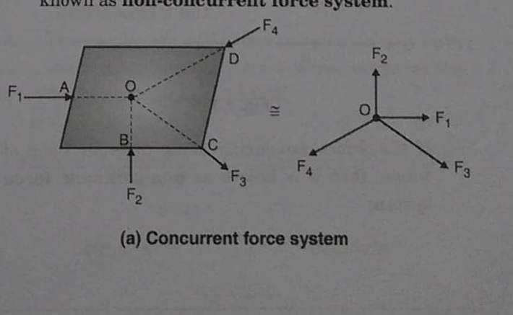
Concurrent and Non-concurrent force system
Lines of action are passing through a common point.
Lines of action are passing through multiple points.
Vishwakarma Institute of Technology
FY - Department of Engineering, Sciences and Humanities
CONCURRENT FORCES
NON CONCURRENT FORCES

Slide 15
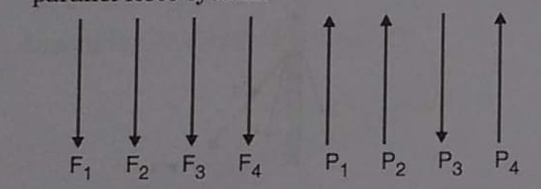
Parallel , Anti Parallel and Non-Parallel Forces
PARALLEL FORCES
ANTI - PARALLEL FORCES
Vishwakarma Institute of Technology
F1
FY - Department of Engineering, Sciences and Humanities
F4
F2
F3
NON-PARALLEL FORCES

Slide 16
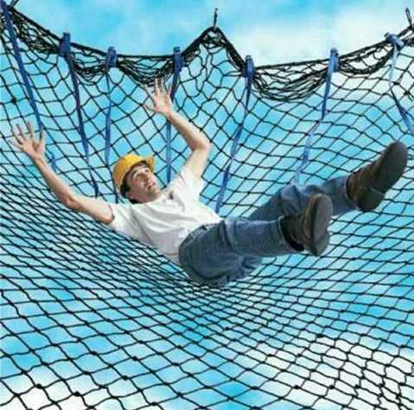
Collinear and Non Collinear force system
Vishwakarma Institute of Technology
FY - Department of Engineering, Sciences and Humanities
SAFETY FALL NET
F4
F3
F2
F1
WHAT IS THIS SYSTEM ?
IS IT NON-CONCURRENT ?
CO-LINEAR FORCE SYSTEM
IS IT CO-PLANER ?
IS IT PARALLEL ?

Slide 17
Principle of Transmissibility of Force -
C
B
A
P
Vishwakarma Institute of Technology
FY - Department of Engineering, Sciences and Humanities
Line of action of the Force
“If a force acts at a point on a rigid body, then it is assumed to act at any point on the line of action of force within the body.”

Slide 18
Resolution of a Force -
Force is a vector quantity. So, it can be assumed to be composed of two fictitious components.
Along….. 1) X axis 2) Y axis
Y
Force F
Vishwakarma Institute of Technology
FY - Department of Engineering, Sciences and Humanities
F sin θ
θ
X
F cos θ

Slide 19
Resultant Force -
F4
F1
F2
F3
F1
Vishwakarma Institute of Technology
FY - Department of Engineering, Sciences and Humanities
F2
F4
Resultant Force
F3
Resultant Force = vector sum of all forces.
(algebraic sum)

Slide 20

Law of Parallelogram of Forces -
R = Resultant is the diagonal
Y
Q
P and Q are coplaner and concurrent forces
θ
P
Vishwakarma Institute of Technology
FY - Department of Engineering, Sciences and Humanities
X
R = P² + Q² + 2 P Q cos
Is Pythagoras theorem related to this ?

Slide 21
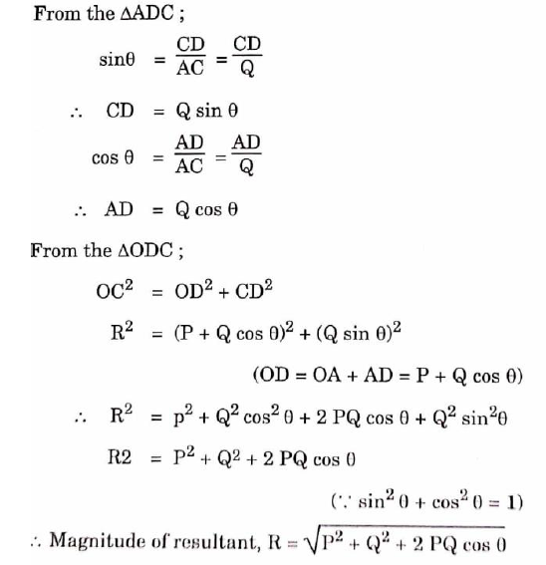
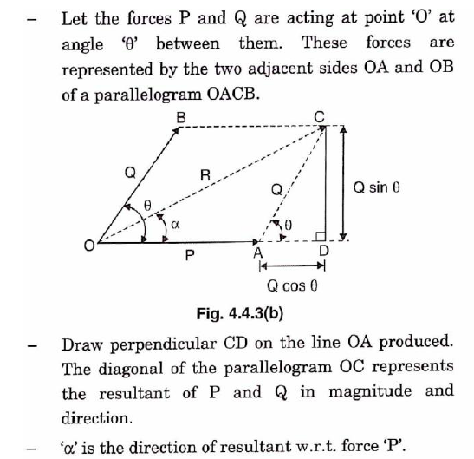
Law Of Parallelogram of Forces - Derivation
Vishwakarma Institute of Technology
FY - Department of Engineering, Sciences and Humanities

Slide 22
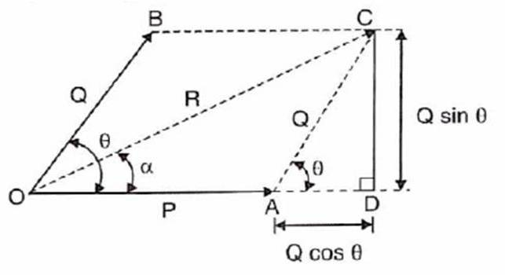
Law Of Parallelogram of Forces -
CD CD Q sin θ
tan α = -------- = -------------- = ------------------
OD OA + AD P + Q cos θ
Vishwakarma Institute of Technology
FY - Department of Engineering, Sciences and Humanities
Q sin θ
α = tan⁻¹ ( --------------------)
P + Q cos θ
IMP Note - α is the angle of the Resultant w.r.t. Force P .

Slide 24
Equilibrium -
A rigid body is said to be in equilibrium, when the resultant of the force system on it is zero.
The resultant of the force system can be a Force or a Moment.
If the resultant is zero, it implies that the resultant force (∑ F) and resultant moment (∑ M) both are zero.
Vishwakarma Institute of Technology
If the resultant force ∑ F = 0, there is No Translation.
FY - Department of Engineering, Sciences and Humanities
If the resultant moment ∑ M = 0, there is No Rotation.
Thus the body is said to be in a …….Complete Static Equilibrium

Slide 25
Equilibrant = the balancing Force which brings ≡m
Equilibrant is a force which is …..
1) equal in magnitude
2) opposite in direction
3) collinear to the resultant of the force system.
Vishwakarma Institute of Technology
FY - Department of Engineering, Sciences and Humanities
Equilibrium is achieved when, all are satisfied.
1) ∑ Fx = 0 ….. X components
2) ∑ Fy = 0 ….. Y components
3) ∑ M = 0 ….. Moments

Slide 26
Free Body Diagram (F.B.D.) - (Short sketch of the system)
In a physical system, to study the equilibrium, the actual machine parts and structures are replaced by respective active, passive forces, reactions and moments.
FBD features ….
It is a sketch of a body of interest only.
All the surrounding bodies are removed.
All of the forces acting on the body are considered and shown.
All of the forces acted by the body on other bodies are NOT considered.
Vishwakarma Institute of Technology
FY - Department of Engineering, Sciences and Humanities

Slide 27
How to draw Free Body Diagram ? -
A sphere of weight W is resting on a rigid wall and is held by a string as shown……
Draw the FBD of the sphere.
T
T
Vishwakarma Institute of Technology
FY - Department of Engineering, Sciences and Humanities
R
R
W
W

Slide 28
Lami's Theorem -
If there are a few forces acting on a body and the body is in a static equilibrium, then according to Lami’s Theorem ……….
P, Q and R are the 3 forces keeping the body in equilibrium.
a, b and c are the respective angles.
P
b
R
Vishwakarma Institute of Technology
FY - Department of Engineering, Sciences and Humanities
P Q R
-------- = --------- = ---------
sin a sin b sin c
c
a
Q
Also called as law of sines.

Slide 29
Numerical Example 1 -
Find the resultant Force R if …..
F1 = 40 N, F2 = 80 N, F3 = 60 N and F4 = 30 N
and the respective angles are ……
θ1 = 45⁰, θ2 = 150⁰, θ3 = 240⁰, θ4 = - 40⁰
F1 = 40 N
F2 = 80 N
150⁰
45⁰
IMP Note - All angles are measured from +ve X axis.
CCW angles are +ve
CW angles are –ve
Thus, + 60⁰ = - 300⁰
Vishwakarma Institute of Technology
FY - Department of Engineering, Sciences and Humanities
−40⁰
F4 = 30 N
240⁰
F3 = 60 N

Slide 30
Ex. 1 Solution -
Resolve each Force into X and Y components and sum up.
Note : F1 = 40 N∠45⁰ is the polar format. Convert it to Rectangular (Cartesian) using P to R function on calculator. Pol (+) and Rec (-)
F1 = 40 N
F2 = 80 N
150⁰
45⁰
F4 = 30 N
R = 50.0242 N
θ = ∠ -174.39⁰
−40⁰
F1 = 40 N ∠45⁰ = ( 28.2842, 28.2842 )
F2 = 80 N ∠150⁰ = ( -69.2820, 40 )
F3 = 60 N ∠240⁰ = ( -30, -51.9615 )
F4 = 30 N ∠- 40⁰ = ( 21.2132, -21.2132 )
Vishwakarma Institute of Technology
FY - Department of Engineering, Sciences and Humanities
240⁰
F3 = 60 N
IMP : All angles are measured from +ve X axis.
CW = – ve and CCW = + ve
Σ Fx = - 49.7846 , Σ Fy = - 4.8905
Convert to Polar
∴ R = 50.0242 N ∠ -174.39⁰ … Answer

Slide 31
Numerical Example 2 -
Find the magnitudes of components of the force F of 750 N in the directions OP and OQ.
Y
Q
15⁰
F = 750 N
65⁰
P
20⁰
?
Vishwakarma Institute of Technology
20⁰
FY - Department of Engineering, Sciences and Humanities
O
X
Can you find this angle ?
What is angle ∠ POQ = ?

Slide 32
Ex. 2 - Solution
This is just opposite to the Parallelogram Law.
15⁰
Q
Y
F = 750 N
20⁰
P
20⁰
Formulae –
F along P = F * [ sin FQ / sin (FP + FQ) ]
F along Q = F * [ sin FP / sin (FP + FQ) ]
O
X
Vishwakarma Institute of Technology
F_{P} = F * [ sin FQ / sin (FP + FQ) ]
= 750 * [ sin 65 / sin (65 + 20) ]
= 682.3273 N
FY - Department of Engineering, Sciences and Humanities
F_{Q} = F * [ sin FP / sin (FP + FQ) ]
= 750 * [ sin 20 / sin (65 + 20) ]
= 257.4949 N ….. Answer

Slide 33
Lines of action are passing through multiple points.
Mechanics – 2.1
Basics of Mechanics
Thanks !
FY – DESH – VIT
Vishwakarma Institute of Technology
FY - Department of Engineering, Sciences and Humanities
F4
F3
F2
F1
NON CONCURRENT FORCES

